Slide 1


Slide 2

Java Secure Sockets Extension -JSSE
JSSE can secure network communications using the Secure Sockets Layer (SSL) Version 3 and Transport Layer Security (TLS) protocols and their associated algorithms
SSL is a security protocol that enables web browsers to talk to web servers using various levels of confidentiality and authentication

Slide 3

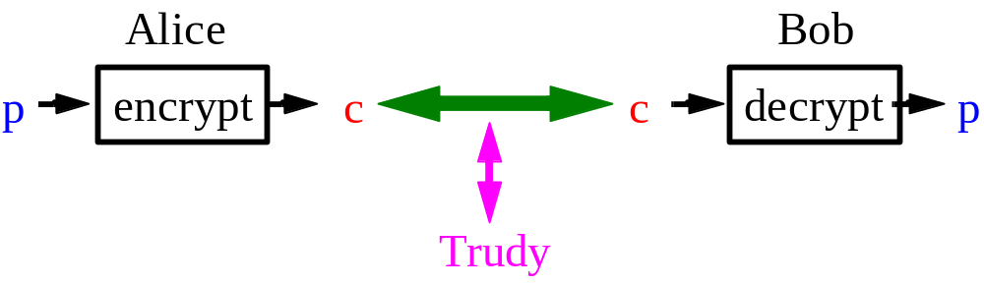
secret key (or symmetric) encryption - the same key is used for both encrypting and decrypting the data
public key (or asymmetric) encryption - different keys are used
Attactks – man-in-the-middle attack
Third-party certification authority

Slide 4
javax.net.ssl
  The abstract classes that define Java's API for secure network communication.
javax.net
  The abstract socket factory classes used instead of constructors to create secure sockets.
javax.security.cert
  A minimal set of classes for handling public key certificates that's needed for SSL in Java 1.1
com.sun.net.ssl
  The concrete classes that implement the encryption algorithms and protocols in Sun's reference implementation of the JSSE.

Slide 5

javax.net.ssl.SSLSocketFactory
public abstract class SSLSocketFactory extends SocketFactory
public static SocketFactory getDefault( ) throws InstantiationException
public abstract Socket createSocket(String host, int port) throws IOException, UnknownHostException
public abstract Socket createSocket(InetAddress host, int port) throws IOException
public abstract Socket createSocket(String host, int port, InetAddress interface, int localPort) throws IOException, UnknownHostException
public abstract Socket createSocket(InetAddress host, int port, InetAddress interface, int localPort) throws IOException, UnknownHostException
public abstract Socket createSocket(Socket proxy, String host, int port, boolean autoClose) throws IOException

Slide 6
SSLSocketFactory factory = (SSLSocketFactory) SSLSocketFactory.getDefault( );
SSLSocket socket = (SSLSocket) factory.createSocket(host, port);
// enable all the suites
String[] supported = socket.getSupportedCipherSuites( );
socket.setEnabledCipherSuites(supported);
Writer out = new OutputStreamWriter(socket.getOutputStream( ));
// https requires the full URL in the GET line
out.write("GET http://" + host + "/ HTTP/1.1\r\n");
out.write("Host: " + host + "\r\n"); out.write("\r\n");
out.flush( );
// read response
BufferedReader in = new SafeBufferedReader( new InputStreamReader(socket.getInputStream( )));

Slide 7

Choosing the Cipher Suites
  public abstract String[] getSupportedCipherSuites( )
  public abstract String[] getEnabledCipherSuites( )
  public abstract void setEnabledCipherSuites(String[] suites)
    It supports 23 suites
    Each name has an algorithm divided into four parts: protocol, key exchange algorithm, encryption algorithm, and checksum.

Slide 8
SSL_RSA_WITH_RC4_128_MD5
SSL_RSA_WITH_RC4_128_SHA
TLS_RSA_WITH_AES_128_CBC_SHA
TLS_DHE_RSA_WITH_AES_128_CBC_SHA
TLS_DHE_DSS_WITH_AES_128_CBC_SHA
SSL_RSA_WITH_3DES_EDE_CBC_SHA
SSL_DHE_RSA_WITH_3DES_EDE_CBC_SHA
SSL_DHE_DSS_WITH_3DES_EDE_CBC_SHA
SSL_RSA_WITH_DES_CBC_SHA
SSL_DHE_RSA_WITH_DES_CBC_SHA
SSL_DHE_DSS_WITH_DES_CBC_SHA
SSL_RSA_EXPORT_WITH_RC4_40_MD5
SSL_RSA_EXPORT_WITH_DES40_CBC_SHA
SSL_DHE_RSA_EXPORT_WITH_DES40_CBC_SHA
SSL_DHE_DSS_EXPORT_WITH_DES40_CBC_SHA
SSL_RSA_WITH_NULL_MD5
SSL_RSA_WITH_NULL_SHA
SSL_DH_anon_WITH_RC4_128_MD5
TLS_DH_anon_WITH_AES_128_CBC_SHA
SSL_DH_anon_WITH_3DES_EDE_CBC_SHA
SSL_DH_anon_WITH_DES_CBC_SHA
SSL_DH_anon_EXPORT_WITH_RC4_40_MD5
SSL_DH_anon_EXPORT_WITH_DES40_CBC_SHA

Slide 9
Example:
  String[] strongSuites = {"SSL_DHE_DSS_WITH_3DES_EDE_CBC_SHA", "SSL_RSA_WITH_RC4_128_MD5", "SSL_RSA_WITH_RC4_128_SHA", "SSL_RSA_WITH_3DES_EDE_CBC_SHA"};
  socket.setEnabledCipherSuites(strongSuites);

Slide 10

public interface HandshakeCompletedListener extends java.util.EventListener
This interface declares the handshakeCompleted( ) method:
public void handshakeCompleted(HandshakeCompletedEvent event)
public class HandshakeCompletedEvent extends java.util.EventObject
The HandshakeCompletedEvent class provides four methods for getting information about the event:
  public SSLSession getSession( )
  public String getCipherSuite( )
  public X509Certificate[] getPeerCertificateChain( ) throws SSLPeerUnverifiedException
  public SSLSocket getSocket( )
public abstract void addHandshakeCompletedListener( HandshakeCompletedListener listener)
public abstract void removeHandshakeCompletedListener( HandshakeCompletedListener listener) throws IllegalArgumentException

Slide 11

public byte[] getId( )
public SSLSessionContext getSessionContext( )
public long getCreationTime( )
public long getLastAccessedTime( )
public void invalidate( )
public void putValue(String name, Object value)
public Object getValue(String name)
public void removeValue(String name)
public String[] getValueNames( )
public X509Certificate[] getPeerCertificateChain( ) throws SSLPeerUnverifiedException
public String getCipherSuite( )
public String getPeerHost( )

Slide 12

public abstract void setUseClientMode(boolean mode) throws IllegalArgumentException
  determines whether the socket needs to use authentication in its first handshake
public abstract boolean getUseClientMode( )
  tells you whether this socket will use authentication in its first handshake
public abstract void setNeedClientAuth(boolean needsAuthentication) throws IllegalArgumentException
public abstract boolean getNeedClientAuth( )
  returns true if the socket requires authentication from the client side, false otherwise

Slide 13

public abstract String[] getSupportedCipherSuites( )
public abstract String[] getEnabledCipherSuites( )
public abstract void setEnabledCipherSuites(String[] suites)

Slide 14

public abstract class SSLServerSocket extends ServerSocket
public abstract class SSLServerSocketFactory extends ServerSocketFactory
public static ServerSocketFactory getDefault( )

Slide 15

public abstract ServerSocket createServerSocket(int port) throws IOException
public abstract ServerSocket createServerSocket(int port, int queueLength) throws IOException
public abstract ServerSocket createServerSocket(int port, int queueLength, InetAddress interface) throws IOException

Slide 16

provides methods to choose cipher suites, manage sessions, and establish whether clients are required to authenticate themselves

Slide 17
public abstract String[] getSupportedCipherSuites( )
public abstract String[] getEnabledCipherSuites( )
public abstract void setEnabledCipherSuites(String[] suites)

Slide 18
Example:
  String[] supported = server.getSupportedCipherSuites( );
  String[] anonCipherSuitesSupported = new String[supported.length];
  int numAnonCipherSuitesSupported = 0;
  for (int i = 0; i < supported.length; i++) {
  if (supported[i].indexOf("_anon_") > 0) {
  anonCipherSuitesSupported[ numAnonCipherSuitesSupported++] = supported[i];
  }
  }

Slide 19
public abstract void setEnableSessionCreation(boolean allowSessions)
public abstract boolean getEnableSessionCreation( )

Slide 20
public abstract void setNeedClientAuth(boolean flag)
public abstract boolean getNeedClientAuth( )
public abstract void setUseClientMode(boolean flag)
public abstract boolean getUseClientMode( )

